Slide 1

Chronic Coronary Syndrome
Prepared By
Dr. Ahmed M. Abdel-Salam
MD cardiology, Ain Shams University

Slide 2
ILOS
At the end of this session, you should
be able to:
Chronic coronary syndrome “CCS” & its etiology.
The pathophysiology of CCS.
Clinical manifestations of CCS.
Differential diagnosis of CCS.
Non-Invasive investigations for CCS.
Different modalities of CCS treatment.
Microvascular angina.
Vasospastic angina.
Refractory angina.

Slide 3
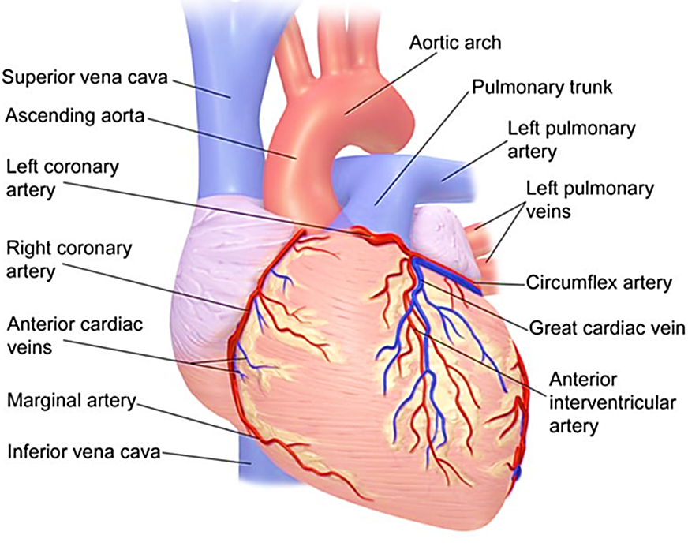
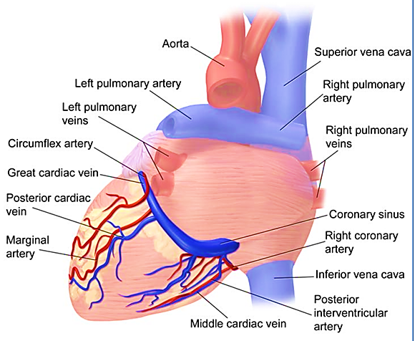
Review of coronary circulation:
Coronary Circulation (Anterior)
Coronary Circulation (Posterior)

Slide 4
Review of coronary circulation:
LAD → Apex, Anterior LV, Anterior 2/3 of IV-Septum
LCX → Lateral LV
RCA → Entire RV, Postero-Superior LV, Posterior 1/3 of IV-Septum
Degrees of Coronary Blockage:
< 70% Occlusion: Asymptomatic
70-75% Occlusion: Angina
90% Occlusion: Chronic IHD
Unstable Plaque: Unstable angina +/- Rupture → Acute MI
> 90% Occlusion: MI

Slide 5
Coronary artery disease:
Coronary artery disease: is the most common cause of angina. It is a pathological process characterized by atherosclerotic plaque accumulation in the epicardial arteries, whether obstructive or non-obstructive.
Ischemic heart disease: is a condition in which there is an inadequate supply of blood and oxygen to portion of the myocardium associated with disturbance in myocardial function.
Occult CAD: is common in those who presented with other forms of atherosclerotic vascular disease, such as intermittent claudication or stroke.

Slide 6
Coronary artery disease:
CAD
IHD
Angina Pectoris
Symptoms of ischemia
(Chest pain)
At rest: Unstable angina.
During exertion: Stable angina.
All patients with coronary artery disease (atherosclerosis)
Cardiac disease as a result of myocardial Ischemia (Imbalance between O2 demand & supply)

Slide 7
Terminology:
Previously
Since 2019
ACS
ACS
CCS
CSA
SCD
ACS: Acute Coronary Syndrome.
CSA: Chronic stable Angina.
SCD: Sudden Cardiac Death.
CCS: Chronic Coronary Syndrome

Slide 8
Chronic Coronary Syndrome:
The 2019 ESC Guidelines replace the term “Stable CAD” with “Chronic Coronary Syndrome”
This implies that CAD is a dynamic process, the clinical presentation of which can be either acute or chronic.
The CCS syndromes have been classified into 6 entities:
1
2
3
4
5
6
Patients with suspected CAD & stable angina symptoms +/- dyspnea
Patients with new onset HF or LV dysfunction & suspected CAD
Asymptomatic & Symptomatic patients with stabilized symptoms < 1 year after ACS or patient with recent revascularization
Asymptomatic & Symptomatic patients > 1 year after initial diagnosis or revascularization
Patients with angina & suspected vasospastic or microvascular disease
Asymptomatic subjects in whom CAD is detected at screening

Slide 9
Chronic Coronary Syndrome:
Pathophysiology
Narrowing of coronary arteries
Insufficient blood flow
Myocardial O2 demands exceed supply
Anaerobic metabolism with lactic acid accumulation
Myocardial nerve fibers irritated
Pain message transmitted to cardiac nerves and upper posterior nerve root

Slide 10
Approach to a patient:

Slide 11
History & risk factors:
A careful history taking and manifestation of CVD and risk factors……….
Family History of CVD.
Dyslipidemia.
Diabetes.
Hypertension.
Smoking.
Other Lifestyle factors.

Slide 12
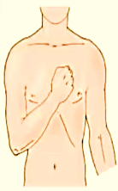
The Characteristics of Angina:
Location | Chest, near the sternum, may be felt anywhere from the epigastrium to the lower jaw or teeth, between the shoulder blades, or in either arm to the wrist and fingers.
Character | The discomfort is often described as pressure, tightness or heaviness; sometimes strangling, constricting or burning.
Duration | The duration of discomfort is a brief, less than 10 minutes in the majority of cases, and more commonly just a few minutes or less. Chest pain lasting for seconds in unlikely to be due to CAD.
Relationship to exertion and other exacerbating or relieving factors | Become more severe with increased levels of exertion.

Slide 13
Clinical Classification of suspected Anginal Symptoms:
Typical Angina | Meets the following three characteristics: Constricting discomfort in the front of the chest or in the neck, jaw, shoulder or arm. Precipitated by physical exertion. Relieved by rest or nitrate within 5 mins.
Atypical Angina | Meet two of these characteristics
Non-anginal chest pain | Meets only one or none of these characteristics

Slide 14
Canadian Cardiovascular Society:
I | Angina only with strenuous exertion | Presence of angina during strenuous, rapid or prolonged ordinary activity (walking or climbing the stairs).
II | Angina with moderate | Slight limitation of ordinary activities when they are performed rapidly, after a meals, in cold, in wind, under emotional stress or during the first few hours, after walking up, climbing more than one flight of ordinary stairs at a normal pace and in a normal conditions.
III | Angina with mild | Having difficulties walking one or two blocks or climbing one flight of stairs, at normal pace and conditions
IV | Angina at rest | No exertion needed to trigger angina

Slide 15
Physical examination:
To access the presence of ……….
Hypertension.
Valvular Heart disease.
Peripheral Vascular disease.
HOCM.
BMI.
Waist circumference.

Slide 16
Investigations:
Biochemical tests……….
CBC.
Fasting blood glucose & HBA1C.
Lipid profile.
Serum creatinine and eGFR.
Serum Uric acid.
Thyroid function test.
Troponin levels “only in suspectedd patients”

Slide 17
Investigations:
Imaging……….
CXR to exclude pulmonary disease, serious conditions as aortic dissection.
Echocardiography: SWMA, Systolic & diastolic LV function.
ECG: During or immediately after chest pain to detect any ischemic changes.
Exercise ECG: in patient with typical chest pain and no resting ECG changes.
Exercise ECHO.
SPECT, CMR, PET.

Slide 18
Management:
Lifestyle modification and control of risk factors.
Pharmacological management.
Revascularization

Slide 19
Lifestyle recommendations:
Smoking Cessation | Using pharmacological & behavioral strategies to help patients quit smoking. Avoid passive smoking.
Physical activity | 30 – 60 min. moderate physical activity most days.
Healthy diet | Diet high in vegetables and whole grain, limited saturated fat
Healthy weight | Obtain and maintain healthy weight ( < 25Kg/m2)
Other | Take medications as prescribed. Sexual activity is low risk for stable patient not symptomatic at low to moderate activity levels

Slide 20
CCS: - Pharmacological treatment
Nitrates:
Acts directly on vascular smooth muscles to produce venous and arteriolar dilation.
They help angina by lowering preload and afterload, which reduces myocardial oxygen demand and by increasing myocardial oxygen supply through coronary vasodilation.
No mortality or morbidity benefits.
Short acting nitrates for acute effort angina: Sublingual and spray nitroglycerine formulation provide immediate relief of effort angina.
Long-acting nitrates for angina prophylaxis.

Slide 21
CCS: - Pharmacological treatment
Beta blockers:
These lowers myocardial oxygen demand by reducing heart rate, BP and myocardial contractility.
Discontinuation should be tapered and not abruptly stopped.
The principal side effects of beat blockers are fatigue, depression, bradycardia, heart block, bronchospasm, peripheral vasoconstriction, postural hypotension, impotence and masking hypoglycemic symptoms.

Slide 22
CCS: - Pharmacological treatment
Calcium Cannel blockers:
These drugs Lower myocardial oxygen demand by reducing BP and myocardial contraction.

Slide 23
CCS: - Pharmacological treatment
Potassium Cannel Activator:
Nicorandil (10 – 30 mg twice daily) is a nitrate derivatives of nicotinamide, with antianginal effects similar to those of nitrates or beta blockers.
Side effects include: nausea, vomiting and potentially severe oral, intestinal and mucosal ulceration.

Slide 24
CCS: - Pharmacological treatment
If current inhibitor:
Ivabradine is the first of this class of drug.
It does not inhibit myocardial contractility and appear to be safe in patients with hear failure.
It includes bradycardia by modulating ion channel in the sinus node.

Slide 25
CCS: - Pharmacological treatment
Ranolazine:
Is a selective inhibitor of the late inward sodium current in coronary artery smooth muscle cell, with a secondary effect on calcium influx and vascular tone, reducing anginal symptoms.
Side effects include dizziness, nausea, constipation, QT prolongation.

Slide 26
CCS: - Pharmacological treatment
Trimetazidine:
It is an anti-ischemic metabolic agent, which improves myocardial glucose utilization through inhibition of fatty acid metabolism, also known as fatty acid oxidation inhibitor.
It is contraindicated in Parkinson’s disease and motion disorders, such as tremors, muscle rigidity, walking disorders and restless leg syndrome.

Slide 27
CCS: - Pharmacological treatment
Event prevention:
Aspirin 75 – 100 mg/day: recommended in patient with previous MI or revascularization.
Clopidogrel 75mg/day: is recommended as an alternative to aspirin in patient with aspirin intolerance.

Slide 28
CCS: - Pharmacological treatment
ACE inhibitors:
ACE inhibitors or ARBs are recommended if a patient has other conditions (e.g. heart failure, hypertension or diabetes).
statins:
It is recommended in all patients with CCS for event prevention.
If a patient’s goal is not achieved with the max. tolerated dose of statin, combination with ezetimibe is recommended.
For patients with a very high risk who do not achieve their goal on a max. tolerated dose of statin + ezetimibe, combination with PCSK9 inhibitor is recommended.

Slide 29
CCS: - Revascularization
In patients with CCS, optimal medical therapy is a key for reducing symptoms, halting the progression of atherosclerosis and preventing atherosclerotic events.
Myocardial revascularization plays a central role in the management of CCS on top of medical treatment, but always as an adjuvant to medical therapy without supplanting it.
Revascularization by PCI or CABG may effectively relieve angina, reduce the use of antianginal drugs and improve exercise capacity and quality of life compared with a strategy of medical therapy alone.

Slide 30
Take Home Message
Chronic Coronary Syndrome (CCS) is part of coronary arterial diseased induced mainly by atherosclerosis.
It is mostly presented by chest pain; however other manifestation may represent angina especially in old age and diabetic termed angina equivalent.
The Differential diagnosis of chest pain may include pleuritic chest pain, esophageal disease, dissecting aortic aneurysm, pulmonary embolism, severe pulmonary hypertension and acute pericarditis.
Investigation for CCS include Laboratory to exclude and follow up risk factors that may precipitate pain. Other investigations include resting & stress ECG, stress ECHO, stress MPI, CTA & CA.

Slide 31
Take Home Message
Treatment of CCS include non pharmacological treatment that aim to life style modification, control of risk factors and weight reduction.
Pharmacological treatment aim to either control of ischemic symptoms by (nitrates, beta blockers, CCBs, Ivabradine, ranolazine, Nicorandil & trimetazidine) or event prevention (mainly statins and anti-thrombotics: Aspirin, P2Y12 blockers.
The third arm in management is revascularization which is indicated in the presence of sizable reversible ischemia +/- significant coronary artery stenosis.

Slide 32

Quiz
Which of the following medications is considered for event prevention:
Ranolazine.
Trimetazidine.
Statins.
Long acting nitrates.
Short acting nitrates.

Slide 33
Quiz
Which of the following medications is considered for event prevention:
Ranolazine.
Trimetazidine.
Statins.
Long acting nitrates.
Short acting nitrates.

Slide 34
Thank You

Slide 35
Thank YOU

